Slide 1

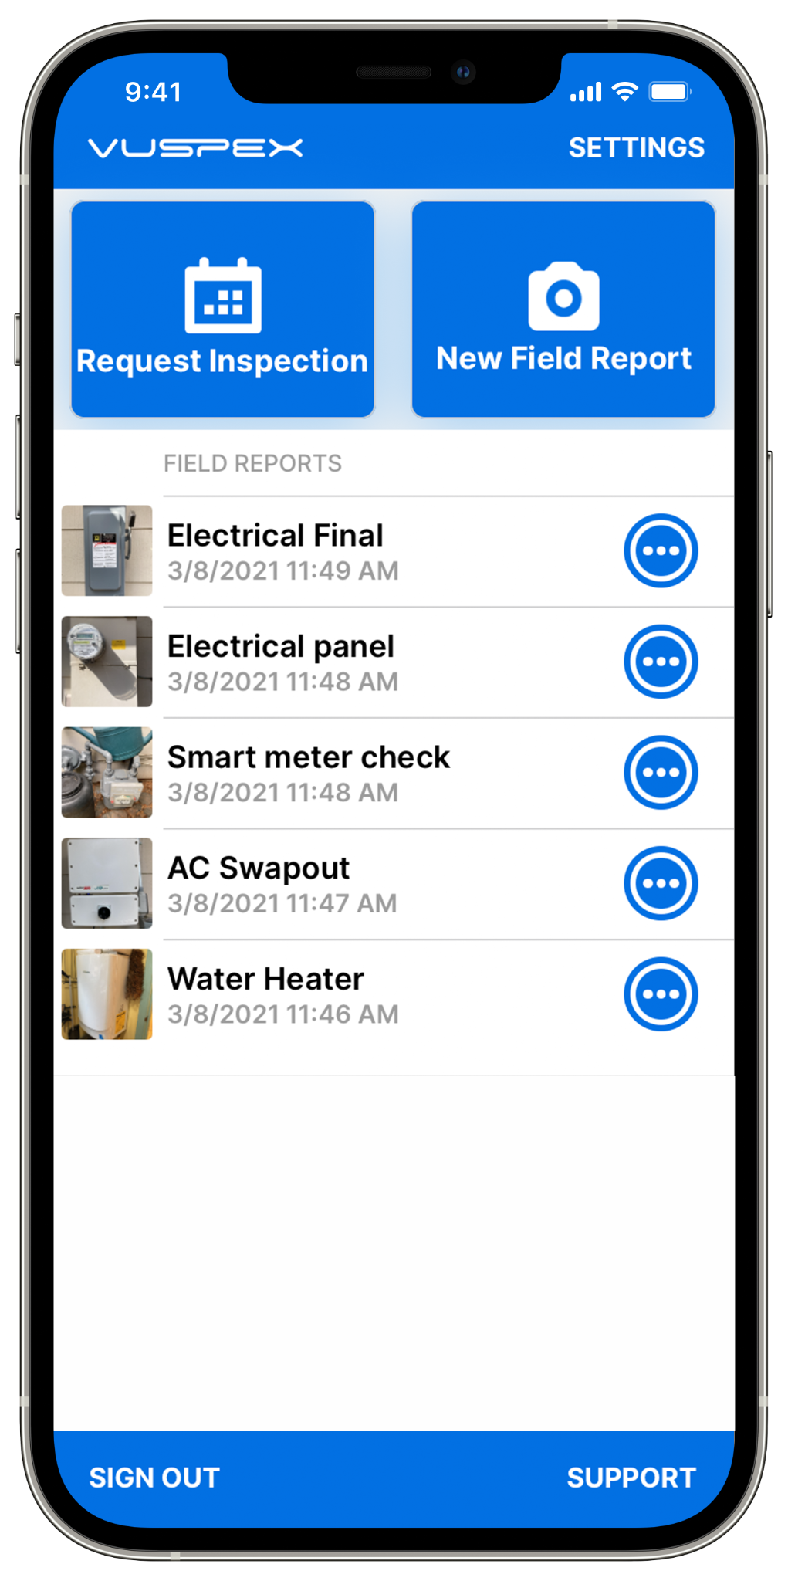

VUSPEX GO
USER GUIDE for CONTRACTORS and HOMEOWNERS
VuSpex GO is an iOS & Android mobile app for Contractors and customers located at the inspection site. The app enables you to:
Create an offline field report (Offline Report) and send it to the inspector.
VuSpex GO is compatible with VuSpex AC, our Accela integrated Inspector-based solution.

Slide 2
Who uses
VUSPEX GO?
Contractors & Homeowners
Inspectors may use VuSpex GO for training and testing purposes
For VuSpex (integrated) customers
Used by permit applicants & homeowners
Mobile users located at the inspection site

Slide 3
Before Getting Started
Things to know
Download the VuSpex GO app to your phone.
Create a VuSpex Contractor account.
  From the VuSpex GO app
  From the User portal

Slide 4




Get VuSpex GO
on your device
Use the app store on your phone to get the app.
Not sure how to do this?
- Talk to your IT Department or have a technical person help you.
iOS (iPhone, iPad)
Tap the App Store icon
Search for ‘VuSpex GO’
Tap the GET button
App Store icon
Android (Smartphone)
Tap the Play Store icon
Search for ‘VuSpex GO’
Tap the Install button
Google Play Store icon

Slide 5
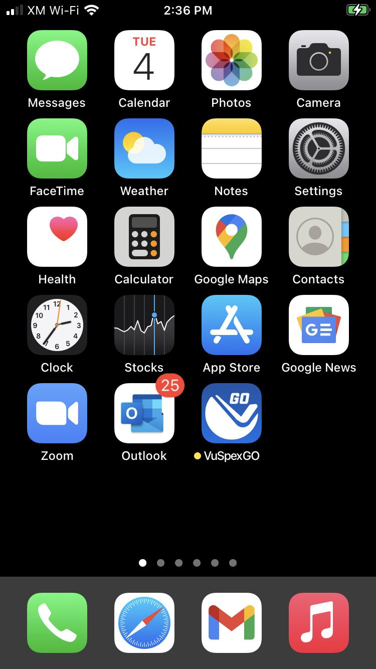
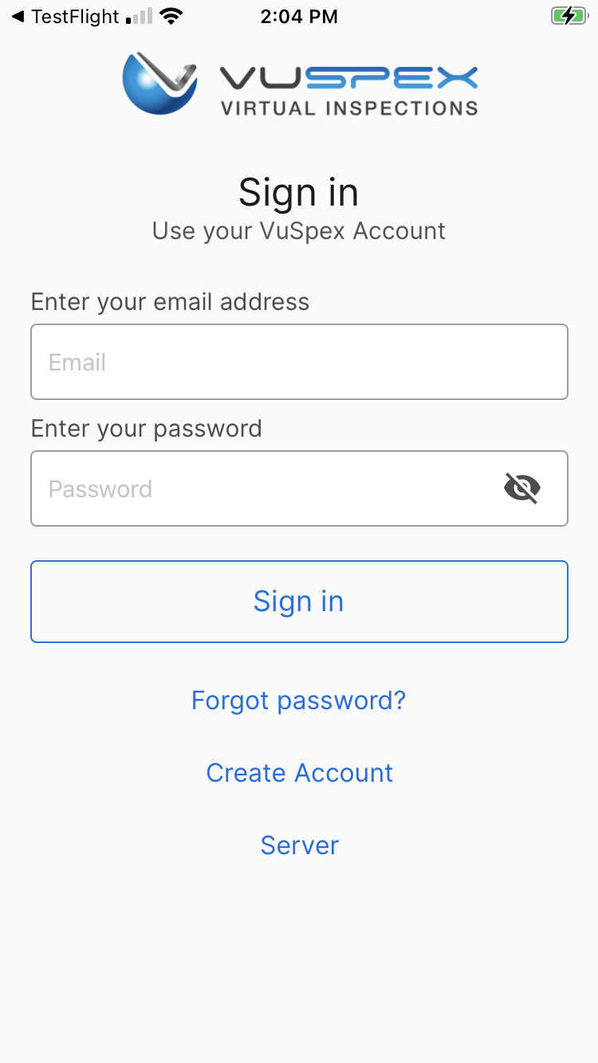
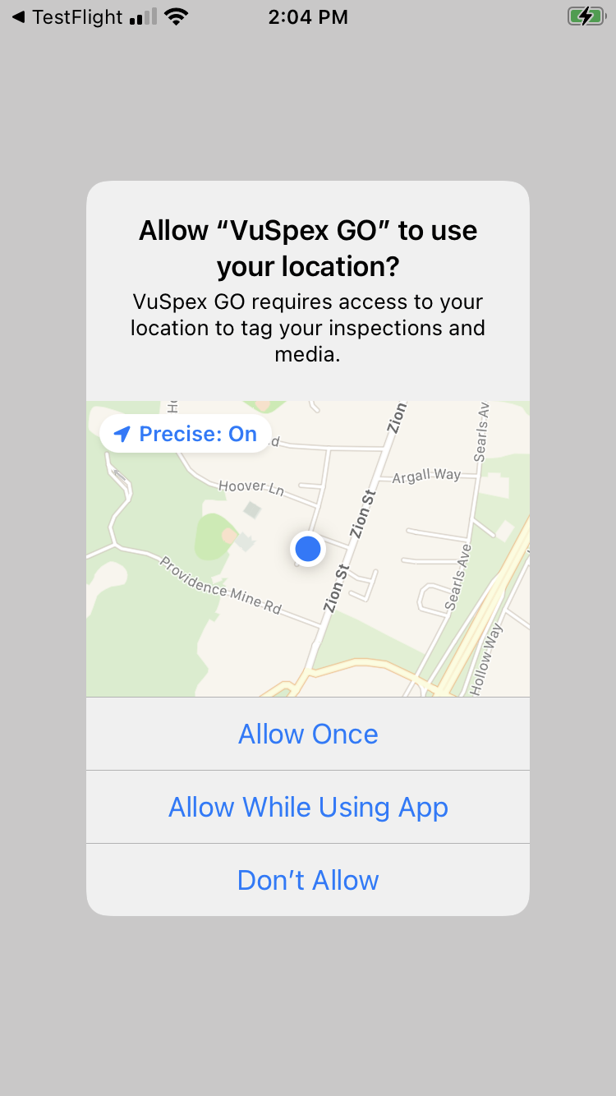
Sign in
1. Launch App
2. Sign in
3. Allow permissions
1. Launch the VuSpex GO app
Tap the icon
2. Sign-in
Enter your VuSpex Contractor account credentials. Same as the VuSpex APP.
3. Allow permissions
Tap ‘Allow While Using App’

Slide 6
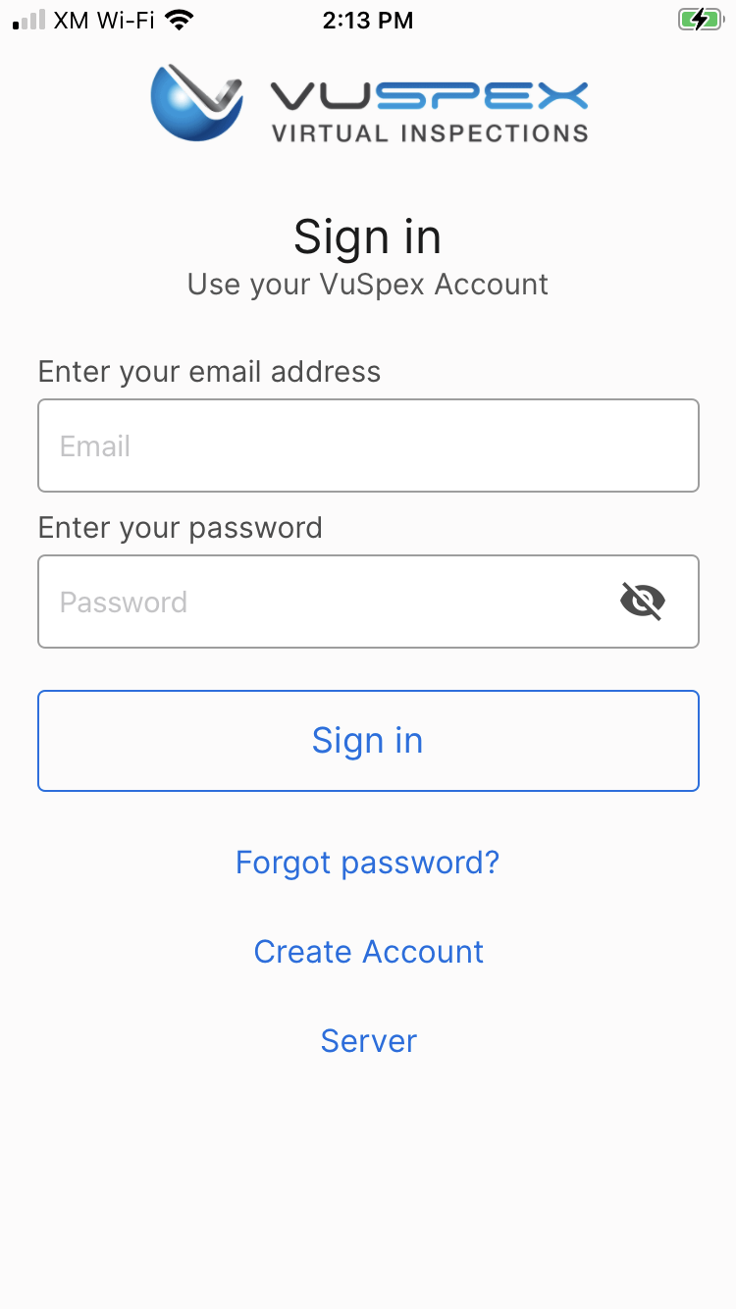
Create an Account
If you do not already have a VuSpex Contractor Account:
Tap ‘Create Account’
Follow the steps to create a new account
Sign in

Slide 7
Forgot password?
If you have a VuSpex Contractor Account, but forgot your password:
Tap ‘Forgot password’
Enter the phone number for your VuSpex Account
Enter the ‘One time code’
Enter the new password
Confirm the password
Tap ‘Reset Password’
Sign in

Slide 8

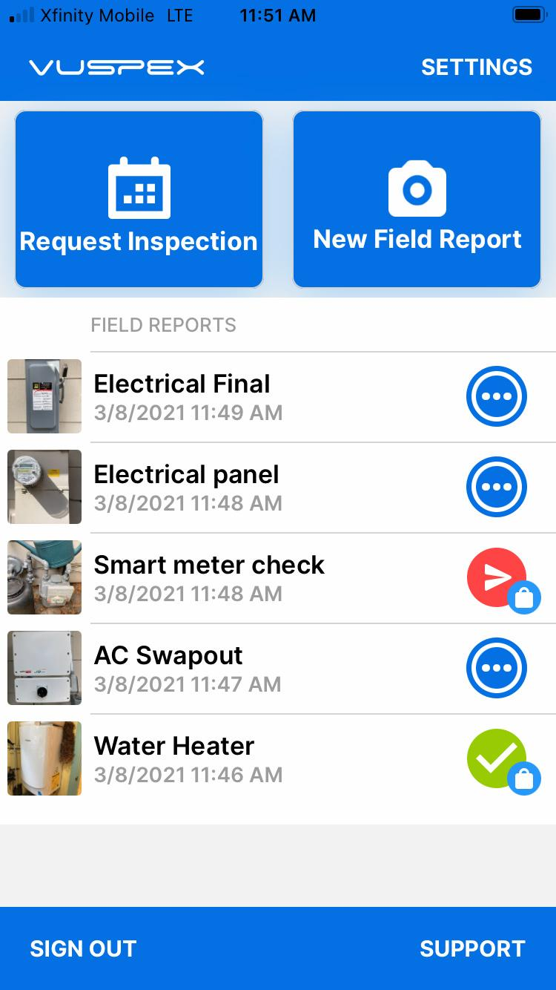
Main Menu Screen
VuSpex GO features:
Offline Field Report (OFR)
Field Report Status / History
Settings menu
Support

Slide 9
Offline Field Report
(OFR)
Note: Your Permit number is required to send a Field Report
A variation of a virtual inspection that does not require an Inspector’s real-time participation. The Contractor independently submits a form containing inspection media.
An inspection report is automatically generated and uploaded to the permit record for the Inspector to review and result the virtual inspection.
Send inspection media to the Inspector at any time.
Rural or congested areas with network connection issues
Limited or no internet connection at the inspection site.

Slide 10
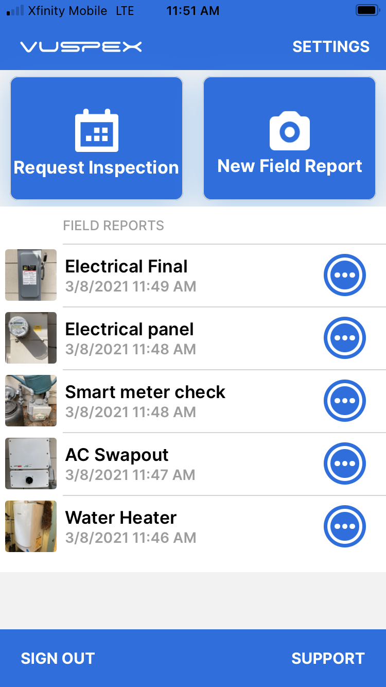
Create a New Field Report
On the Main Menu
Tap the ‘New Field Report’ button at the inspection location.
Note: Your Permit number is required to send a Field Report.
You must take photos & videos with the GO app for guaranteed GPS verification.

Slide 11
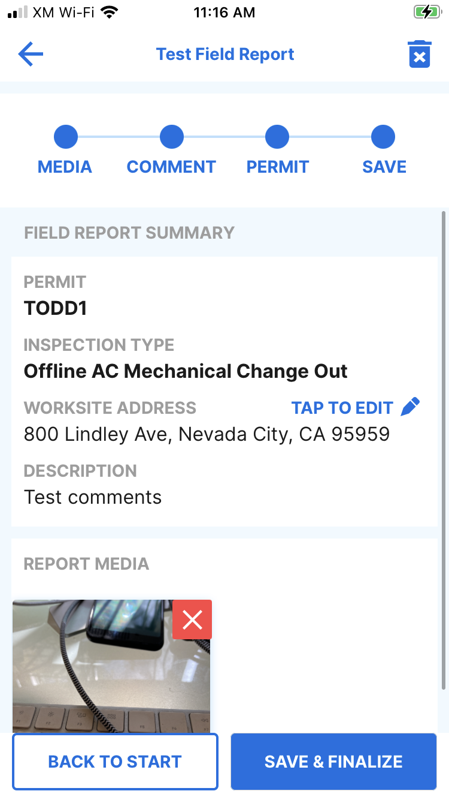
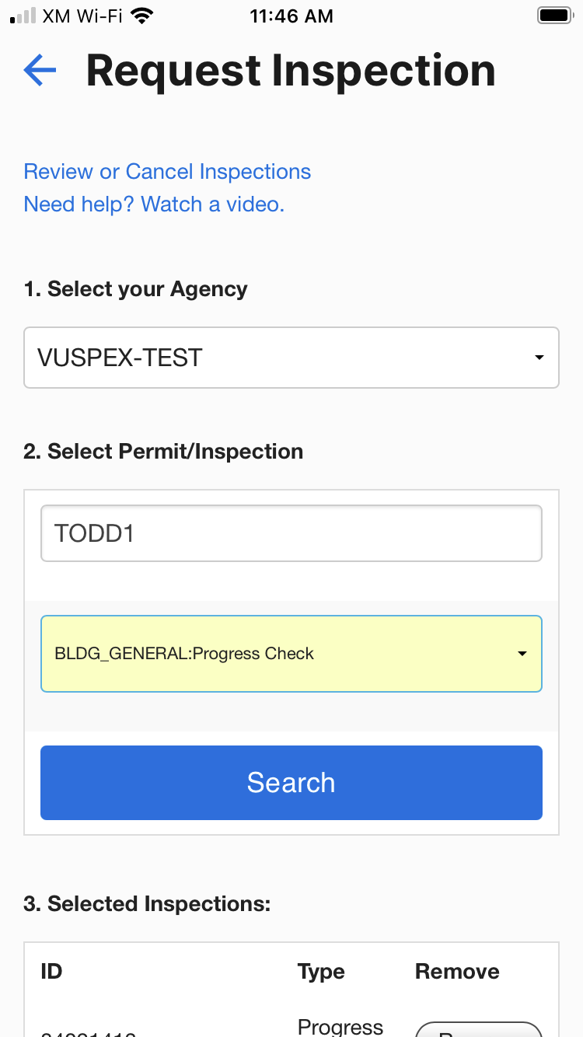
Offline Field Report (OFR)
Fill out the step-by-step form
Step 1 - MEDIA: Add photos & videos with comments.
Step 2 - COMMENT: Add a description.
Step 3 - PERMIT: Agency, permit, & inspection type.
Step 4 - SAVE: Finalizing the report locks it from being edited. Then send the Field Report to the Inspector when you have a good internet connection.

Slide 12
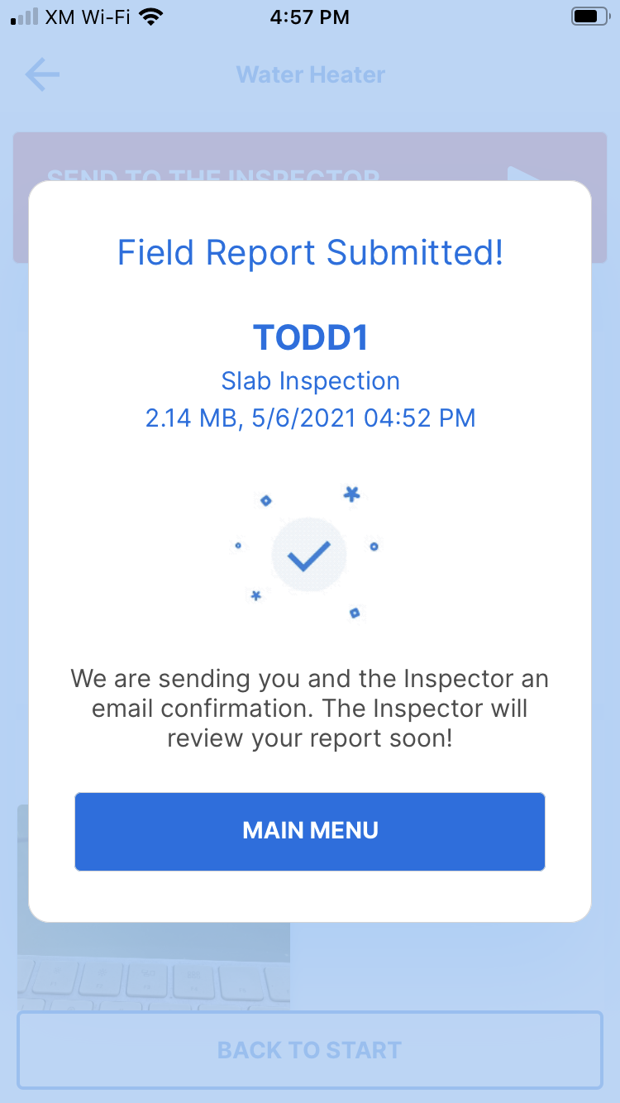
Offline Field Report
How-To Basics
Ask your Inspector about Offline Field Reports
Works for many inspection types
Automatically saves as you go
Begin the report without an internet connection
Your permit number is required to send
Send the report at a location with a good cellular or WiFi internet connection

Slide 13
Saved Field Report Status
Field Reports are saved and listed on the Main Menu
Blue dots icon: Saved work-in-progress. Can be edited.
Red send icon: Saved and finalized but has not been sent to the Inspector yet. Cannot be edited.
Green check icon: Saved and finalized and sent to the Inspector. Good to go!

Slide 14
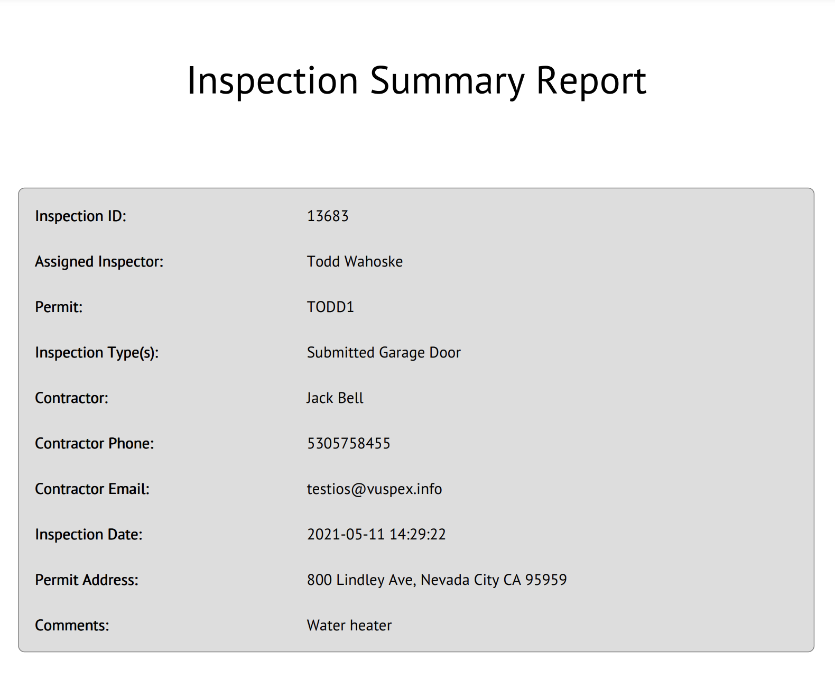




Field Report Summary
Automatically notifies and uploads to the Inspector
PDF format
GPS coordinate verification
Date and timestamp
Permit information
Inspection type
Inspector information
Inspection Media: Photos, video links, comments
Stored in VuSpex CLOUD

Slide 15
Settings
Menu
Adjust your Account information.
Link a new Agency where you work.
Tap the ‘Settings’ link in the upper-right corner to open.

Slide 16
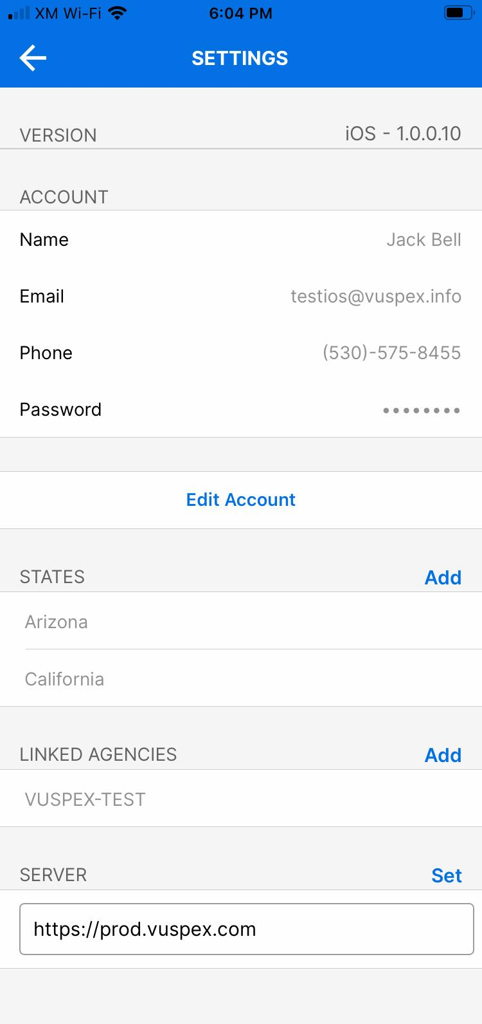
Settings Menu
App Version
Account information
Edit Account button
States (where you work)
Linked Agencies (State, County, City, Company)
Server: prod.vuspex.com (do not change this setting)

Slide 17

VUSPEX SUPPORT - CONTACT
MONDAY - FRIDAY
Hours: 8 AM to 5 PM PT
Email: support@vuspex.com
Phone: (844) 288-7739 ext. 2 Leave a detailed voicemail
Online: https://vuspex.com/support/ Visit our Support page

Slide 18
VUSPEX SUPPORT - LINKS
VuSpex GO Support
https://www.vuspex.com/support.html

